Slide 1
Networks and communication
Module 5
Routing protocols (Part 2)
Dr.S.L.JAYALAKSHMI,
VIT Chennai

Slide 2
Outline
Link State Routing
Reliable Flooding
Example
Implementation
Performance analysis
Packet Tracer

Slide 3
Link State Routing
Initial state : similar to distance vector i.e., state of link to neighbors known (up/down).
goal: To find the path of least cost to destination.
Basic Idea -- Every node knows how to reach its neighbors. If this info is dissemination to every node, every node ultimately has the info. to build the complete map of the network.
Notes:
Link-state
In contrast to distance vector routing, link state routing (OSPF, ISIS) relies on each node advertising/flooding the state (i.e. delay, bandwidth etc) of their links to every node within the link state domain. This results in each node building a complete map of the network (shortest path tree), with itself as the root using the shortest path first algorithm, also known as the Dijkstra algorithm.
Unlike distance vector link-state neighbours only sends incremental routing updates (LSAs) rather than a full routing update. Also, these updates are only sent at the point a change in the network topology occurs, rather than at regular intervals.
Link-state protocols provide extremely low convergence times and, due to each router having a complete view of the network, aren't prone to the same routing loops seen with DV-based protocols.
However, due to the computation required for the algorithms to run across the shortest path trees upon each node, greater resources are consumed compared to that of distance vector, however, this really isn't a concern with the systems of today.

Slide 4
Mechanisms
Two mechanisms:
Reliable dissemination of link state information -- process is called reliable flooding.
calculation of routes using the collected information -- the computation is based on Dijkstra’s algorithm.

Slide 5
Reliable Flooding
Process of making sure that all the nodes participating in the link state routing protocol get a copy of the link-state info. from all other nodes.
Each node sends out link-state information on its directly connected links.
Each node that receives this, forwards it.

Slide 6
Link State Information
Each node creates a link-state packet (LSP) that contains:
ID of the node that created LSP
a list of directly connected nodes and the cost to each node.
sequence number
TTL
}
for reliability

Slide 7
An Example
X receives LSP from some node Y.
X checks to see if it already has an update from Y. If it does, it compares the sequence number in the new LSP to the one stored.
If New seq no < Old sequence number, then, discard LSP.
Else -- store LSP and send the LSP to all neighbors except the one that sent the LSP.
If no update from Y, keep it.

Slide 8
Dissemination of LSPs
LSPs are sent periodically (upon the expiry of a timer) or may be triggered due to a change in topology (as in RIP).
The only topology change that triggers the creation of a new LSP is a change to one of the directly connected links.
Failures detected by link layer protocol by using what are known as “HELLO” packets -- probes to determine if neighbor is alive.

Slide 9
Dissemination of LSPs
To minimize overhead, LPSs are not created unless needed --periodicity is of the order of hours.
Sequence numbers help in identifying new info and TTL helps in ensuring that packets don’t stay in the network indefinitely.

Slide 10
Graph abstraction
Used for computation of shortest path using Dijkstra’s.
Let N denote the set of nodes in the graph.
l(i,j) denotes the non-negative cost or weight associated with the edge between nodes i and j.
l(i,j) = ∞ if there is no edge between i and j.
Remember -- each node has entire map of network.

Slide 11
An Example
B
3
2
7
C
A
8
1
D

Slide 12
Steps for building routing table of node D
Steps | Confirmed | Tentative | Comments
1 | (D,0,-) |  | Since D is the only new member of the confirmed list, look at its LSP.
2 | (D,0,-) | (B,8,B) (C,1,C) | D’s LSP says we can reach B through B at cost 8, which is better than anything else on either list. So put it on Tentative list; same for C
3 | (D,0,-) (C,1,C) | (B,8,B) | Put lowest-cost member of Tentative(C) onto confirmed list. Next, examine LSP of newly confirmed member (C)
4 | (D,0,-) (C,1,C) | (B,3,C) (A,8,C) | Cost to reach B through C is 3, so replace (B,8,B). C’s LSP tells that we can reach A at cost 8.
5 | (D,0,-) (C,1,C) (B,3,C) | (A,8,C) | Move lowest-cost member of tentative (B) to confirmed , then look at its LSP.
6 | (D,0,-) (C,1,C) (B,3,C) | (A,6,C) | Since we can reach A at cost 3 through B, replace the Tentative entry.
7 | (D,0,-) (C,1,C) (B,3,C) (A,6,C) |  | Move lowest-cost member of Tentative(A) to confirmed and we are all done.

Slide 13
An Example
B
2
4
9
C
A
10
3
D

Slide 14
Steps for building routing table of node D
Steps | Confirmed | Tentative
1 | (D,0,-)
2 | (D,0,-) | (B,10,B) (C,3,C)
3 | (D,0,-) (C,3,C) | (B,10,B)
4 | (D,0,-) (C,3,C) | (B,5,C) (A,12,C)
5 | (D,0,-) (C,3,C) (B,5,C) | (A,12,C)
6 | (D,0,-) (C,3,C) (B,5,C) | (A,9,C)
7 | (D,0,-) (C,3,C) (B,5,C) (A,9,C)
B
4
9
C
A
10
3
D

Slide 15
OSPF (Open Shortest Path First)
“Open”: publicly available
Uses Link State algorithm
link state (LS) packet dissemination
topology map at each node
route computation using Dijkstra’s algorithm

Slide 16
OSPF “Advanced” Features (not in RIP)
Multiple same-cost paths allowed (only one path in RIP)
For each link, multiple cost metrics for different Type Of Service (eg, satellite link cost set “low” for best effort; high for real time)
Security: all OSPF messages authenticated (to prevent malicious intrusion); TCP connections used
Hierarchical OSPF

Slide 17

Hierarchical OSPF
Boundary Router
Backbone
Area 0
Area
Link-state advertisements only in area .
each nodes has detailed area topology;
only know direction (shortest path) to nets in other areas.
Backbone Router
runs OSPF routing limited to backbone.
Area 1
Area 2
Area Border Router
” distances to nets in own area, advertise summarize to other Area Border routers.
Two-level hierarchy: local area, backbone

Slide 18
Implementation
There is a very simple way to build a switch or router:
Buy a general-purpose processor and equip it with a number of network interfaces. Such a device, running suitable software, can receive packets on one of its interfaces, perform any of the switching or forwarding functions, and send packets out another of its interfaces.

Slide 19
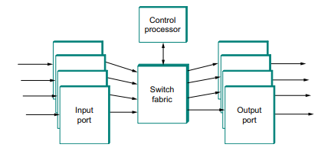
Block diagram of Router
Source: Computer Networks:
A Systems Approach, Larry Peterson and Bruce Davie, 5th Ed, The Morgan Kaufmann Series, Elsevier, 2011.
Notes:
First, routers must be designed to handle variable length packets, a constraint that does not apply to ATM switches but is certainly applicable to Ethernet or Frame Relay switches.
It turns out that many high-performance routers are designed using a switching fabric that is cell based.
In such cases, the ports must be able to convert variable length packets into cells and back again. This is known as segmentation and re-assembly (SAR), a problem also faced by network adaptors for ATM networks

Slide 20
Performance analysis
Key Differences Between RIP and OSPF based on performance
RIP depends on hop counts to determine the best path while OSPF depends on cost (bandwidth) which helps in determining the best path.
Administrative Distances (AD) measures the probity of received routing information on a router from a neighbor router. An administrative distance can vary from integers 0 to 255, where 0 specifies the most trusted integer, and 255 signifies that no traffic is allowed to pass through this route. The AD value of RIP is 120 whereas it is 110 for OSPF.
Convergence in the RIP is slow in contrast it is fast in OSPF.
Summarization allows a single routing table entry to illustrate a collection of IP network numbers. RIP supports auto summarization, as against OSPF supports manual summarization.
There no hop count limit in OSPF. On the contrary, the RIP is limited to 15 hop counts.

Slide 21
Packet Tracer
Packet Tracer is a cross-platform visual simulation tool designed by Cisco Systems that allows users to create network topologies and imitate modern computer networks.
The software allows users to simulate the configuration of Cisco routers and switches using a simulated command line interface.
https://www.wikihow.com/Configure-a-Network-on-Cisco-Packet-Tracer

Slide 22
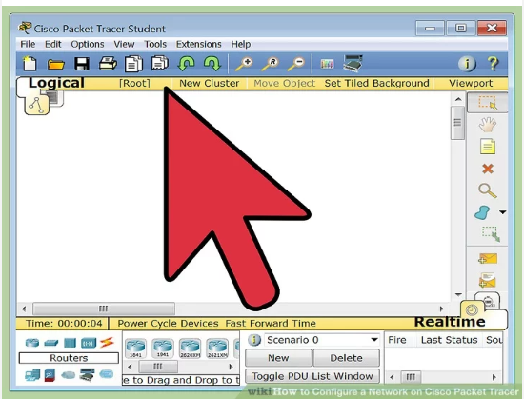
Packet tracer
Step 1:
Open your Network Topology. Once you've opened your Network Topology on Cisco Packet Tracer, access your network and identify the components of your network, for example; Servers, Routers, End Devices, etc.

Slide 23
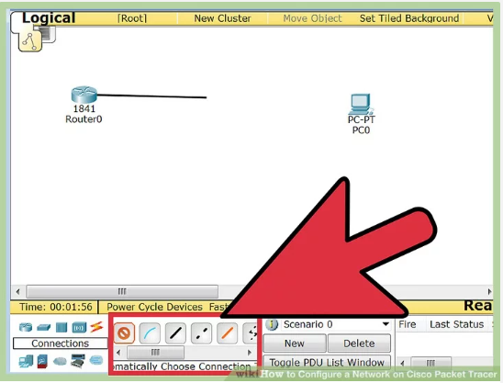
Packet tracer
Step 2:
Complete the cabling. Access the cables section and connect completely and correctly the cables between the network in order to ensure connectivity between the devices in the network using the connections table given.

Slide 24
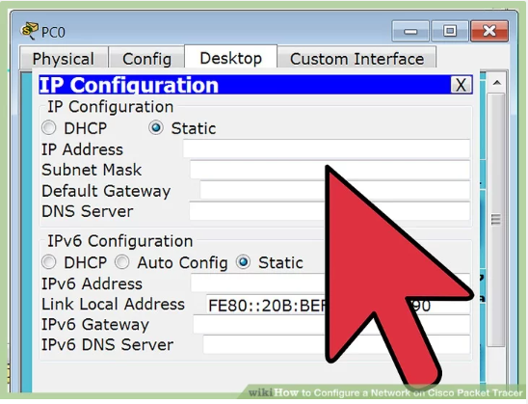
Packet tracer
Step 3:
Open your Network Topology. Once you've opened your Network Topology on Cisco Packet Tracer, access your network and identify the components of your network, for example; Servers, Routers, End Devices, etc.

Slide 25
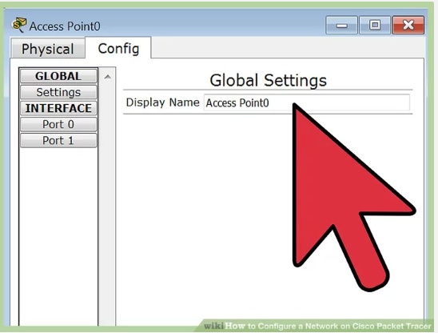
Packet tracer
Step 4:
Configure the IP addresses on your routers and switches. After configuring the right IP addresses on the end devices, you will have to do the same on the routers and switches also, using the address table. But this time in a different way because there's no desktop platform on the routers and switches.

Slide 26
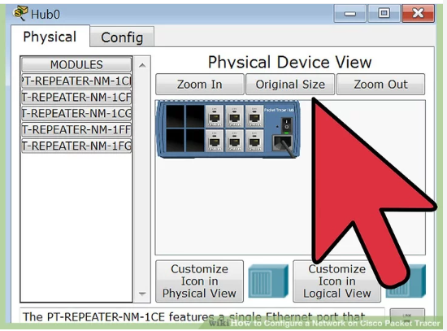
Packet tracer
Step 5:
Configure your default gateway. After configuring the IP addresses, you will need to configure the default gateway also. The reason for this is so the end devices would know what network they are operating on. You can find the default gateway either in the addressing table (if given) or in the network topology.

Slide 27
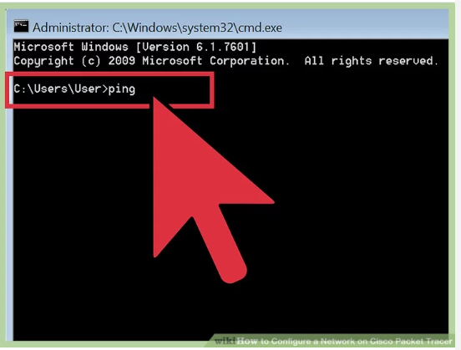
Packet tracer
Step 6:
Test connectivity. After configuring the addresses, you will have to test connectivity by opening a command prompt window on the end devices and try pinging the address which the network operates on. If it gives you a reply, it means your network was configured correctly.

